Slide 1

Section 1.4 Loss of Significance
Lecture 1
Evading machine error
Notes:
Short sectoin. Already seen problems.

Slide 2

Homework Submission to Canvas
Preview of section
Skim the section in text and write a short paragraph summary.
Give a bulleted list of all important definitions, theorems, and formulas without details.
Notes on video lectures
Take notes on everything written on slides including all details, worked examples, on-own activities, as well as your own thoughts and questions.
Try on-own activities first, then write down provided solution next to it for comparison.
Worked examples from the text
Write down the problem and attempt without looking at the solution.
Use the solution to write the best explanation you can.
Solutions to textbook exercises
Model approaches and explanations given in the video lectures and textbook examples.
Final reflection of section
List the key takeaways to remember as a bulleted list.
Notes:
Mention graded for completion and quality of writing.

Slide 3
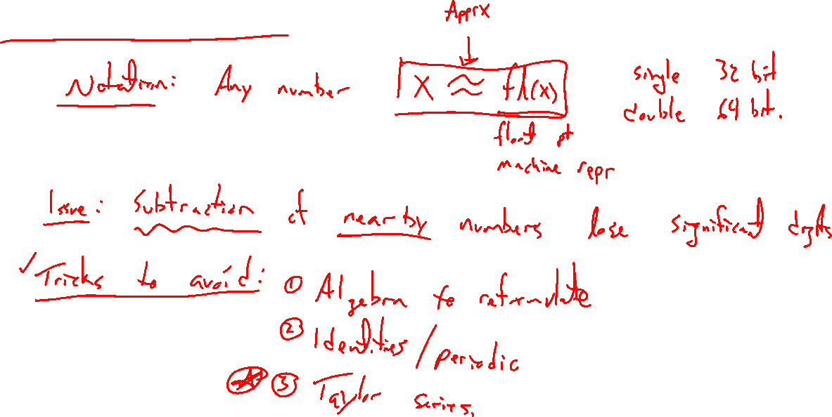
Short and sweet
Notes:
Notation: x ~ fl(x) = floating pt representation of x
Issue: Subtraction of closeby numbers and loss of significance.
Tricks to avoid: Algebra to reformulate, identities, Taylor series, periodicity
See text

Slide 4

Section 1.4: Textbook Examples and Exercises
Theorem proofs: None
Text examples 1, 2, 3, 4, 5.
Write down a problem. Close the book and attempt on own.
Check / correct your solution against the text solution.
If needed, rewrite the problem to be of the quality of the text solution.
Text exercises NONE.
Write solutions of the same quality as in lecture and text solutions.
Text computer exercises 1, 3, 4, 9.
Record screenshots of your script and corresponding outputs.

Slide 5

Homework Submission to Canvas
Preview of section
Skim the section in text and write a short paragraph summary.
Give a bulleted list of all important definitions, theorems, and formulas without details.
Notes on video lectures
Take notes on everything written on slides including all details, worked examples, on-own activities, as well as your own thoughts and questions.
Try on-own activities first, then write down provided solution next to it for comparison.
Worked examples from the text
Write down the problem and attempt without looking at the solution.
Use the solution to write the best explanation you can.
Solutions to textbook exercises
Model approaches and explanations given in the video lectures and textbook examples.
Final reflection of section
List the key takeaways to remember as a bulleted list.
Notes:
Mention graded for completion and quality of writing.

